Slide 1
Object-Oriented Analysis and Design using JAVA
B.Tech (CSE/IT) 5th SEM
2020-2021
Lecture-20 Collaboration diagram or Communication diagram

Slide 2
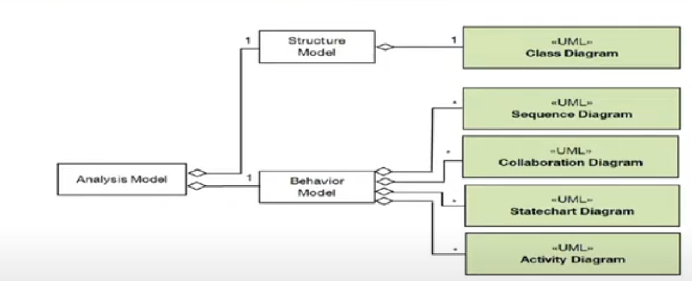
Where used?
Communication diagram is a result of analysis phase

Slide 3
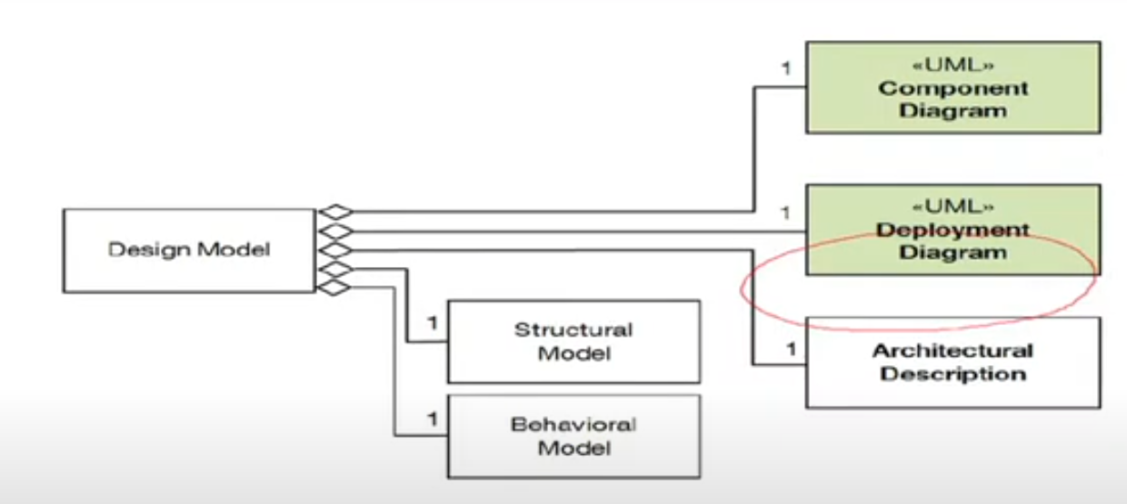
Where used?
Refined in the design phase and included in behavioral model

Slide 4
Introduction
The collaboration diagram is used to show the relationship between the objects in a system.
Both the sequence and the collaboration diagrams represent the same information but differently.
Instead of showing the flow of messages, it depicts the architecture of the object residing in the system as it is based on object-oriented programming.
An object consists of several features. Multiple objects present in the system are connected to each other.
The collaboration diagram, which is also known as a communication diagram, is used to portray the object's architecture in the system.
Reference: https://www.javatpoint.com/uml-collaboration-diagram/
Notes:
In sequence diagram, sequencing is temporal (the order of message is according to time) while in communication diagram the order of space is preferred. o1--m1-->o2--m2→ … and so on . The messages are not necessarily be in time order. (space means→ how object recv and send msgs and how they communicate)

Slide 5
Notations of a Collaboration Diagram
Following are the components of a component diagram that are enlisted below:
Objects: The representation of an object is done by an object symbol with its name and class underlined, separated by a colon.
In the collaboration diagram, objects are utilized in the following ways:
The object is represented by specifying their name and class.
It is not mandatory for every class to appear.
A class may constitute more than one object.
In the collaboration diagram, firstly, the object is created, and then its class is specified.
To differentiate one object from another object, it is necessary to name them.
Reference: https://www.javatpoint.com/uml-collaboration-diagram/

Slide 6
Actors: In the collaboration diagram, the actor plays the main role as it invokes the interaction. Each actor has its respective role and name. In this, one actor initiates the use case.
Links: The link is an instance of association, which associates the objects and actors. It portrays a relationship between the objects through which the messages are sent. It is represented by a solid line. The link helps an object to connect with or navigate to another object, such that the message flows are attached to links.
Reference: https://www.javatpoint.com/uml-collaboration-diagram/

Slide 7
Steps for Creating Collaboration Diagrams
Identify behavior whose realization and implementation is specified
Identify the structural elements (class roles, objects, subsystems) necessary to carry out the functionality of the collaboration
Decide on the context of interaction: system, subsystem, use case and operation
Model structural relationships between those elements to produce a diagram showing the context of the interaction
Consider the alternative scenarios that may be required
Draw instance level collaboration diagrams, if required.
Optionally draw a specification level collaboration diagram to summarize the alternative scenarios in the instance level sequence diagrams
Reference: https://www.visual-paradigm.com/guide/uml-unified-modeling-language/what-is-uml-collaboration-diagram/

Slide 8
Major components
Frames
Lifeline
Messages

Slide 9
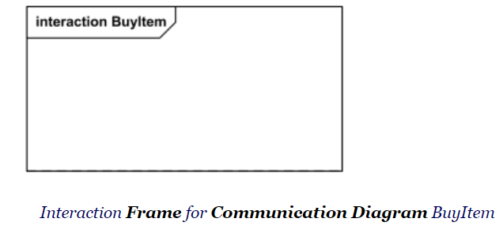
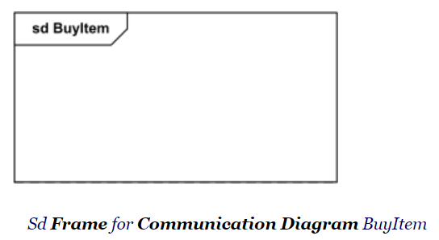
Frame
Communication diagrams could be shown within a rectangular frame with the name in a compartment in the upper left corner.

Slide 10
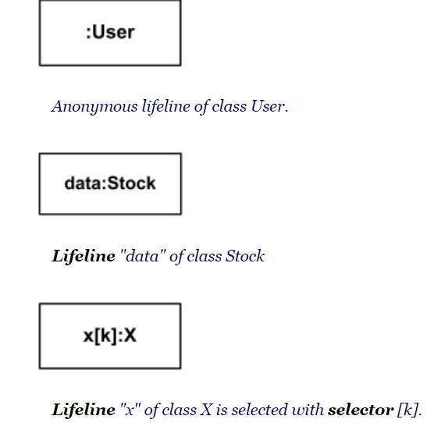
Lifeline
Lifeline is a specialization of named element which represents an individual participant in the interaction.
The lifeline head has a shape that is based on the classifier for the part that this lifeline represents. Usually the head is a white rectangle containing name of the class after colon.

Slide 11
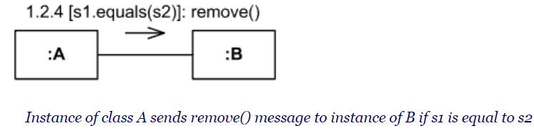
Message
Message in communication diagram is shown as a line with sequence expression and arrow above the line. The arrow indicates direction of the communication.

Slide 12
Sequence Expression
The sequence expression is a dot separated list of sequence terms followed by a colon (":") and message name after that:
sequence-expression ::= sequence-term '.' . . . ':' message-name
For example, 3b.2.2:m5
contains sequence expression 3b.2.2 and message name m5.
sequence-term ::= [ integer [ name ] ] [ recurrence ]
The integer represents the sequential order of the message within the next higher level of procedural calling (activation). Messages that differ in one integer term are sequential at that level of nesting.
Notes:
sequence-term ::= [ integer [ name ] ] [ recurrence ]

Slide 13
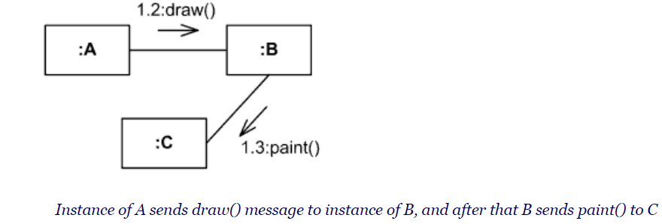
For example,
message with sequence 2 follows message with sequence 1,
2.1 follows 2
5.3 follows 5.2 within activation 5
1.2.4 follows message 1.2.3 within activation 1.2.

Slide 14
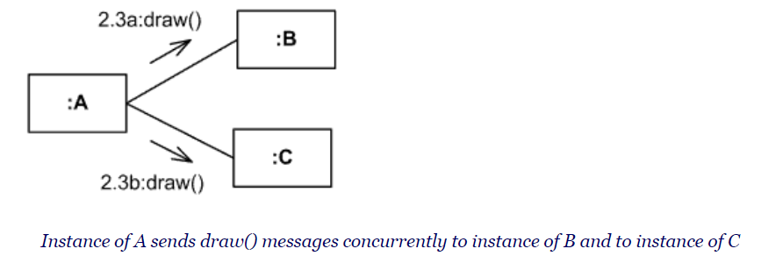
The name represents a concurrent thread of control. Messages that differ in the final name are concurrent at that level of nesting.
For example,
messages 2.3a and 2.3b are concurrent within activation 2.3,
1.1 follows 1a and 1b,
3a.2.1 and 3b.2.1 follow 3.2.

Slide 15
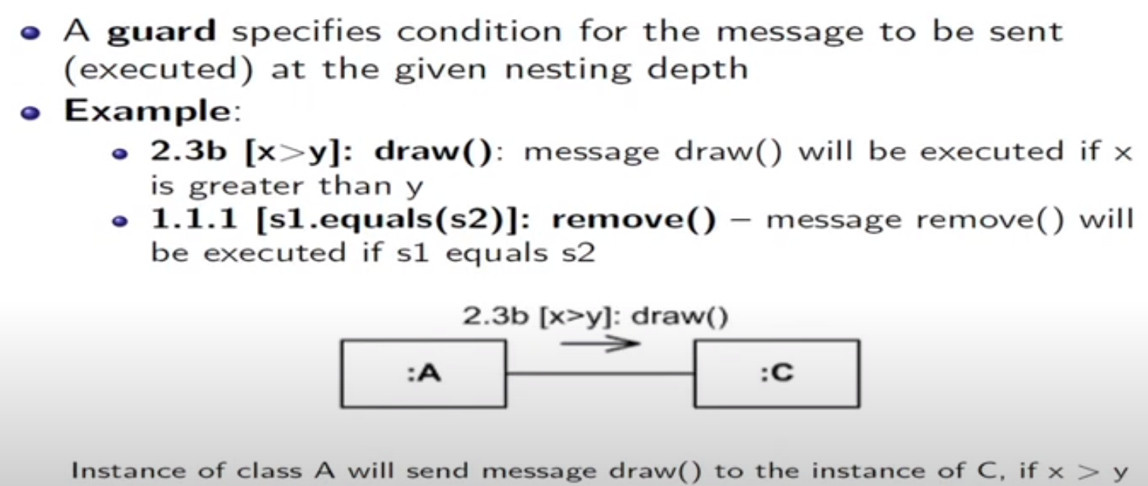
Sequence Expression: Guards

Slide 16
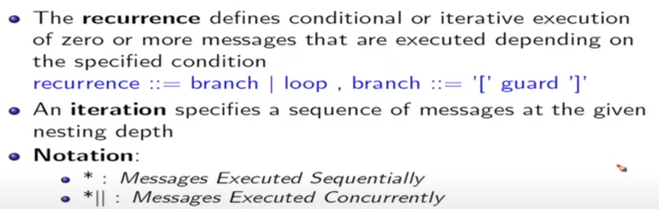
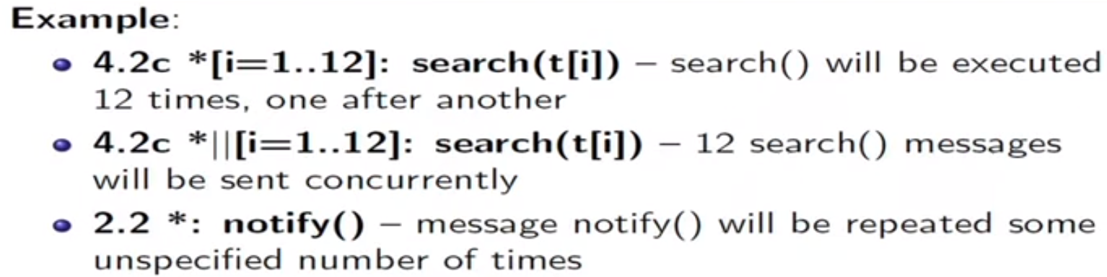
Sequence Expression: Recurrence and Iteration

Slide 17
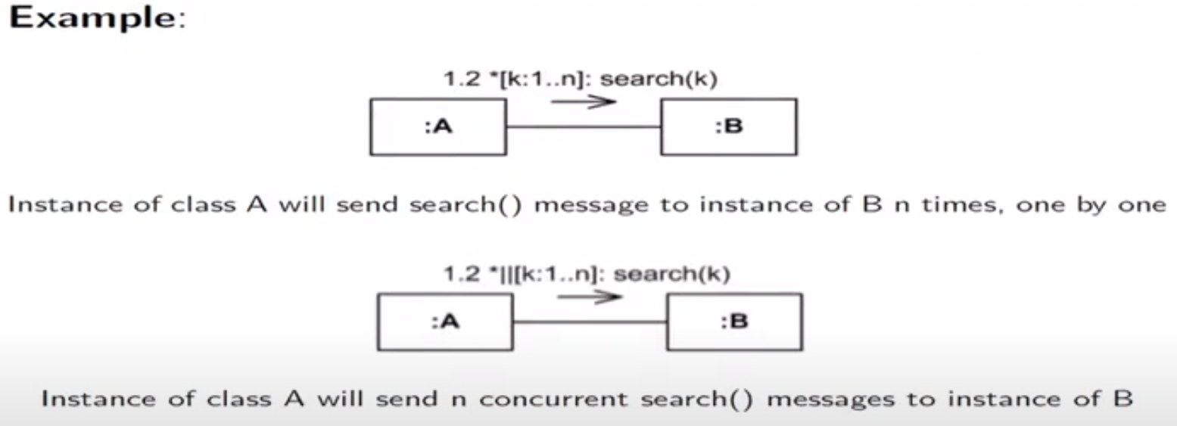
Sequence Expression: Recurrence and Iteration

Slide 18
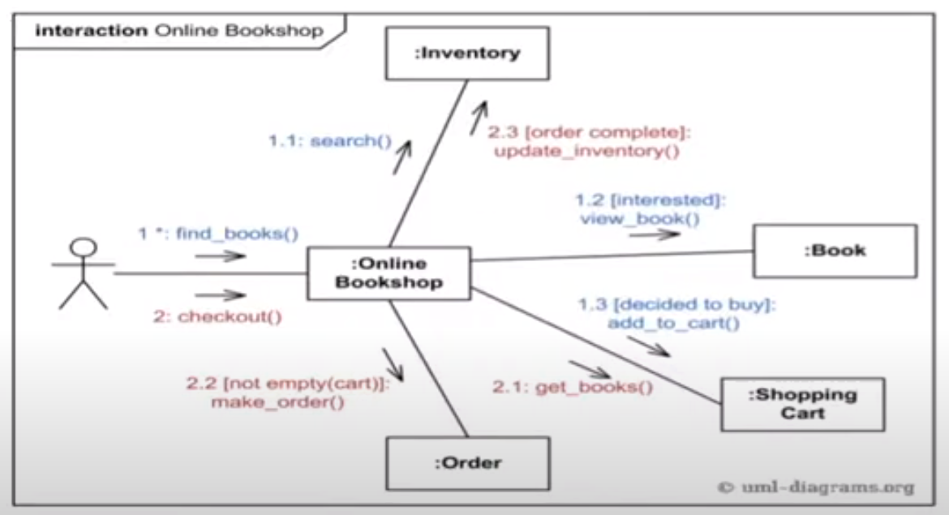
Online Book Shop

Slide 19
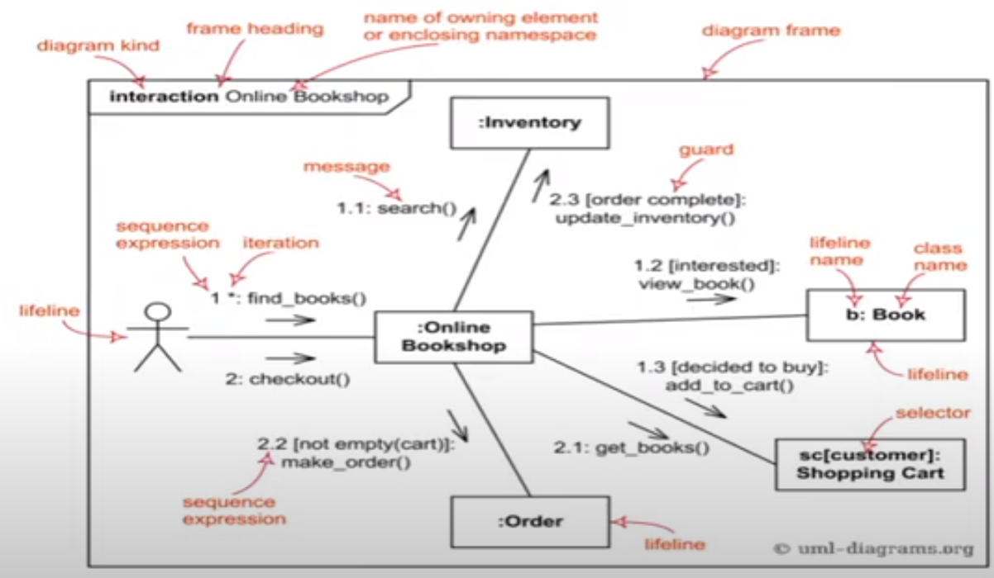

Slide 20
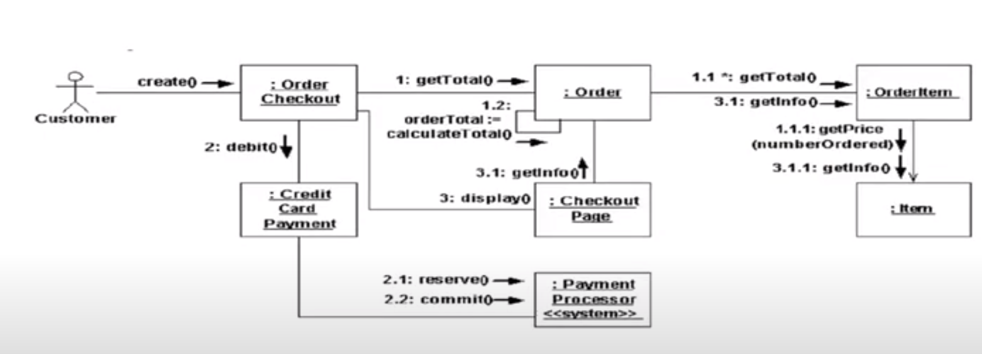
Order Management

Slide 21
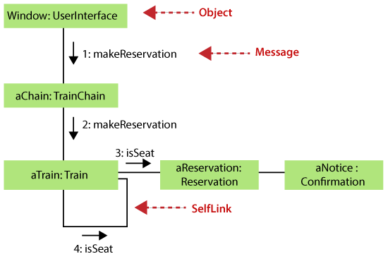
Collaboration Diagram Example
Reference: https://www.javatpoint.com/uml-collaboration-diagram/

Slide 22
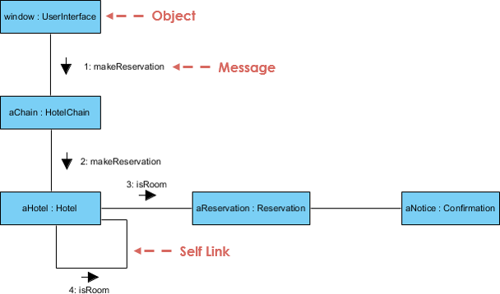
Collaboration Diagram Example
Reference: https://www.visual-paradigm.com/guide/uml-unified-modeling-language/what-is-uml-collaboration-diagram/

Slide 23
Benefits of Collaboration Diagram
The collaboration diagram is also known as Communication Diagram. It mainly puts emphasis on the structural aspect of an interaction diagram, i.e., how lifelines are connected.
The syntax of a collaboration diagram is similar to the sequence diagram; just the difference is that the lifeline does not consist of tails.
The messages transmitted over sequencing is represented by numbering each individual message. The collaboration diagram is semantically weak in comparison to the sequence diagram.
The special case of a collaboration diagram is the object diagram. It focuses on the elements and not the message flow, like sequence diagrams.
Since the collaboration diagrams are not that expensive, the sequence diagram can be directly converted to the collaboration diagram.
There may be a chance of losing some amount of information while implementing a collaboration diagram with respect to the sequence diagram.
Reference: https://www.visual-paradigm.com/guide/uml-unified-modeling-language/what-is-uml-collaboration-diagram/

Slide 24
Key references
Unified Modeling Language (UML): Complete Guide & Examples
-By James Rumbaugh, Ivar Jacobson, Grady Booch
https://www.javatpoint.com/uml-collaboration-diagram/ : https://www.visual-paradigm.com/guide/uml-unified-modeling-language/what-is-uml-collaboration-diagram/

Slide 25
Key references
Unified Modeling Language (UML): Complete Guide & Examples
-By James Rumbaugh, Ivar Jacobson, Grady Booch
https://www.guru99.com/uml-activity-diagram.html
https://creately.com/blog/diagrams/sequence-diagram-tutorial/

Slide 26
Thank You

